Slide 1

Creating Your First ERC 20 Token!

Slide 2
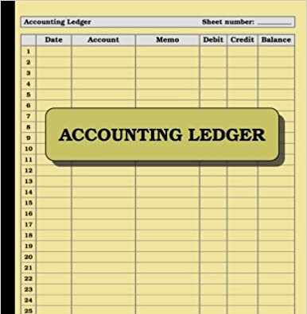
Blockchain
A distributed and decentralized ledger
A ledger is simply a logbook of transactions which tracks when money is sent from one account to another
The key difference between the ledger at your bank and a blockchain such as bitcoin is decentralization

Slide 3

Ethereum
Ethereum extended blockchain beyond handling simple transfers of money from one party to another
Ethereum transactions allows for any arbitrary code execution to be considered a transaction
These complex transactions are executed by smart contracts

Slide 4
Smart Contracts
Combination of API + Database
Just like an API, it has methods a client can call
Unlike an API it has its own persistent storage as well
The most common programming language for Smart Contract is called Solidity (looks a lot like JavaScript)
Tokens (Fungible or NFTs) are implemented by smart contracts

Slide 5
Tokens
A digital asset defined by a smart contract
The token smart contract:
Stores the token balance per user
Defines the logic for transferring tokens from one user to another
Stores any metadata e.g. the token name, symbol etc.

Slide 6





Fungible vs Non-Fungible Tokens
Replace the word fungible with interchangeable
Fungible tokens are like dollars, non-fungible tokens (NFT) are like baseball cards
ERC-20 is the standard for fungible tokens on Ethereum

Slide 7

Wallets And Addresses
Wallets hold digital assets including tokens
The most popular wallet for Ethereum is MetaMask which is a browser extension
A wallet will have an address, which is essentially its identifier
Addresses look like this:
0x18B733cE9661190fFE3728561B9dCc0F60f8c694
0x0823cA4422DfE3aC8e3cC66ceb7a1d4EA2eea519

Slide 8
MetaMask Token Demo
Show token balances
Show transfer of tokens

Slide 9
Project Setup
Prereqs
Node must be installed
Install Remixd package globally
npm install -g @remix-project/remixd
Clone Repo
Run remixd -s <LocalRepo Absolute Path>\contracts
Run Remix in the browser (https://remix.ethereum.org) with localhost option

Slide 10
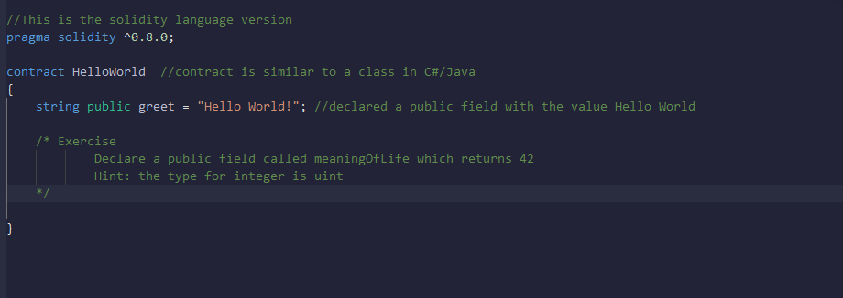
Hello World Example
helloWorld.sol
Public field

Slide 11
Functions Example
functions.sol
Functions to retrieve state and set state

Slide 12
Validation Example
In Solidity the require statement is frequently used for validation
The usage is the following:
require(<condition>, <error message>);
Example in validation.sol
Exercise in validationExercise.sol

Slide 13
Address Example
In Solidity, the address type is used to represent addresses. These could be addresses of wallets or smart contracts.
msg.sender is a special variable and refers to the address which is calling the function
Example in address.sol
Exercise in addressExercise.sol

Slide 14
Mappings Example
In Solidity, one of the most important data types is called a mapping
Mappings are key-value pairs (basically like dictionaries in C#)
Mappings are frequently used to track balances among other things
Example and exercise in mapping.sol
mapping (<keyType> => <valueType>)

Slide 15
Events Example
Solidity functions can emit events
These events can be listened for by any application, including front-end apps
Example in event.sol and Exercise in eventExercise.sol
event <EventName>(<indexed> <paramType1> paramName1, <indexed> <paramType2> paramName2, …);

Slide 16
ERC 20 Token
ERC 20 token contracts should implement IERC20 and IERC20Metadata
https://github.com/OpenZeppelin/openzeppelin-contracts/blob/v4.5.0/contracts/token/ERC20/IERC20.sol
https://github.com/OpenZeppelin/openzeppelin-contracts/blob/v4.5.0/contracts/token/ERC20/extensions/IERC20Metadata.sol
Follow the steps in the tokenStart.sol file to complete the implementation

Slide 17
More Resources
https://www.learnweb3.io/
UDEMY Course:
https://accelerate.udemy.com/course/blockchain-developer/

